Slide 1
ELINET symposium on digital literacy:
New conceptual tools for understanding and researching
digital information
1 Colin Harrison, University of Nottingham
2 Jeroen Clemens, Clemens Concepts
3 Sari Sulkunen, University of Jyväskylä (Chair)
4 Sandra Langer, University of Education Weingarten
ELINET Symposium at FELA-Crete2024.com

Slide 2
ELINET symposium on digital literacy:
New conceptual tools for understanding and researching
digital information
Conceptual tools for evaluating Critical Digital Literacy
Colin Harrison, University of Nottingham
This presentation can be found at https://colinharrison.org/

Slide 3
    1990 Tim Berners-Lee sets up the WorldWideWeb with the intention of creating a platform for ‘the free and open worldwide exchange of information’ (Berners-Lee and Cailliau, 1990).
    2018 Berners-Lee expresses alarm at three trends: ‘Fake news’, Personal surveillance, Cyber warfare (2018).
    2022. If 'truth' is contextual, contested and geographical, what are the implications for teaching critical digital literacy?

Slide 4
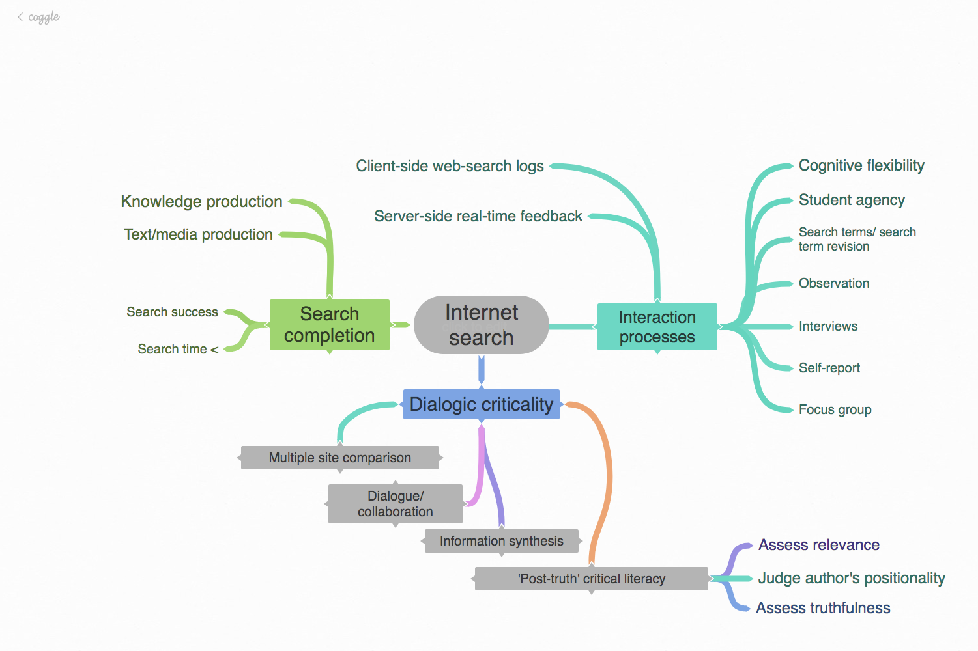
    1990 Tim Berners-Lee sets up the WorldWideWeb with the intention of creating a platform for ‘the free and open worldwide exchange of information’ (Berners-Lee and Cailliau, 1990).
    2018 Berners-Lee expresses alarm at three trends: ‘Fake news’, Personal surveillance, Cyber warfare (2018).
    2022. If 'truth' is contextual, contested and geographical, what are the implications for teaching critical digital literacy?
How have researchers explored students’ Internet searching?

Slide 5
How have researchers explored students’ Internet searching?

Slide 6


Tim Berners-Lee hoped that the Internet would be a liberating, safe, open and authoritative learning environment. However…
Google now searches 25 billion websites that lead to hundreds of billions of web pages
- Google paid content gets 65% of clicks; unpaid content only 35%
- 76% of all websites send tracker data via cookies to Google (generally sent to about 100+ companies unless you opt out)
- 95% of web searches end on p. 1

Slide 7
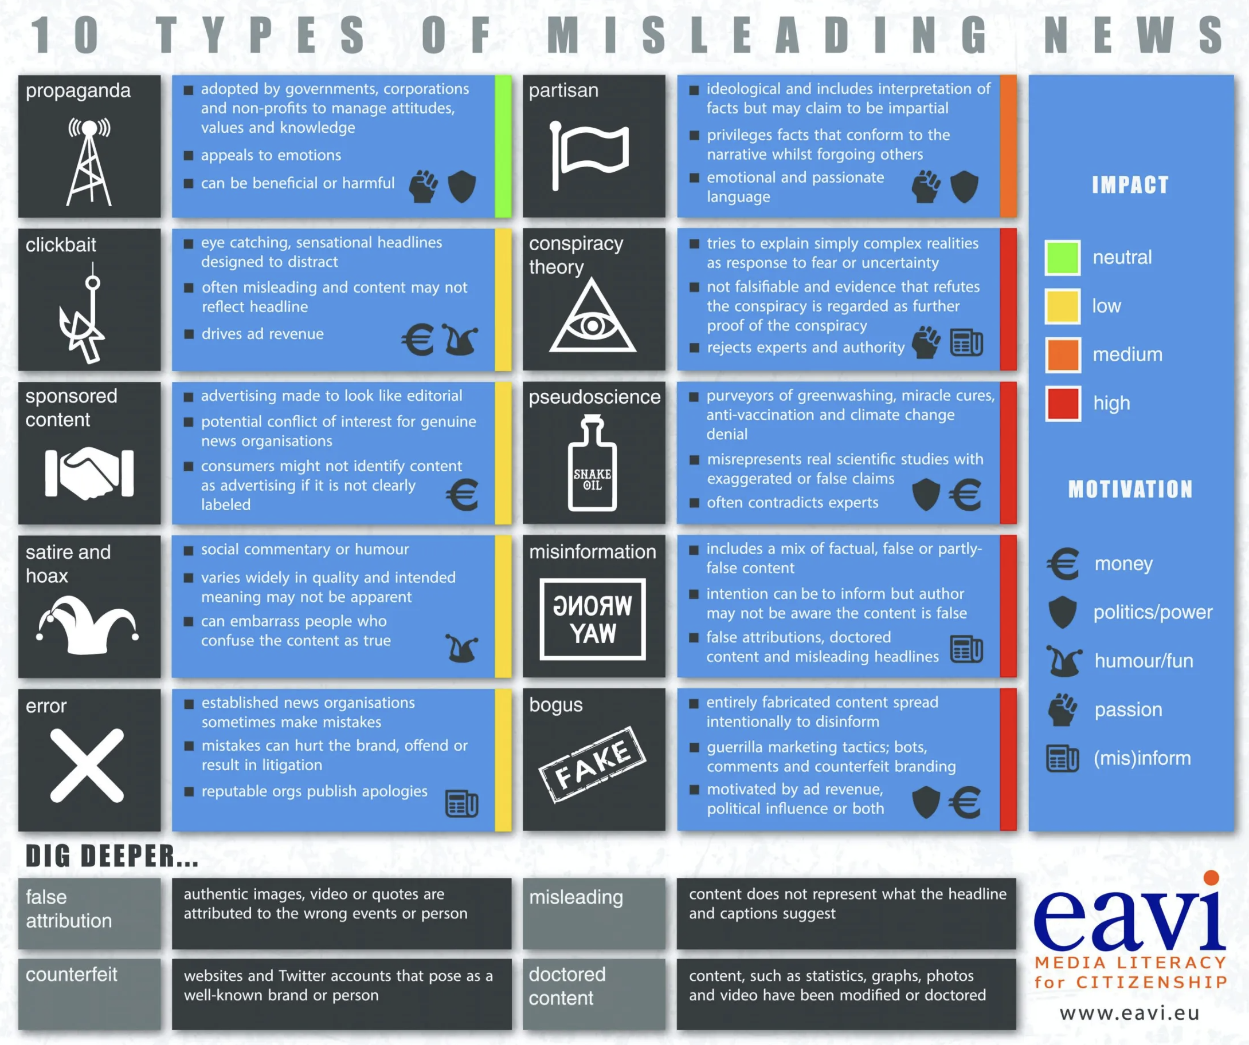
    2022. If 'truth' is contextual, contested and geographical, what are the implications for teaching critical digital literacy?

Slide 9
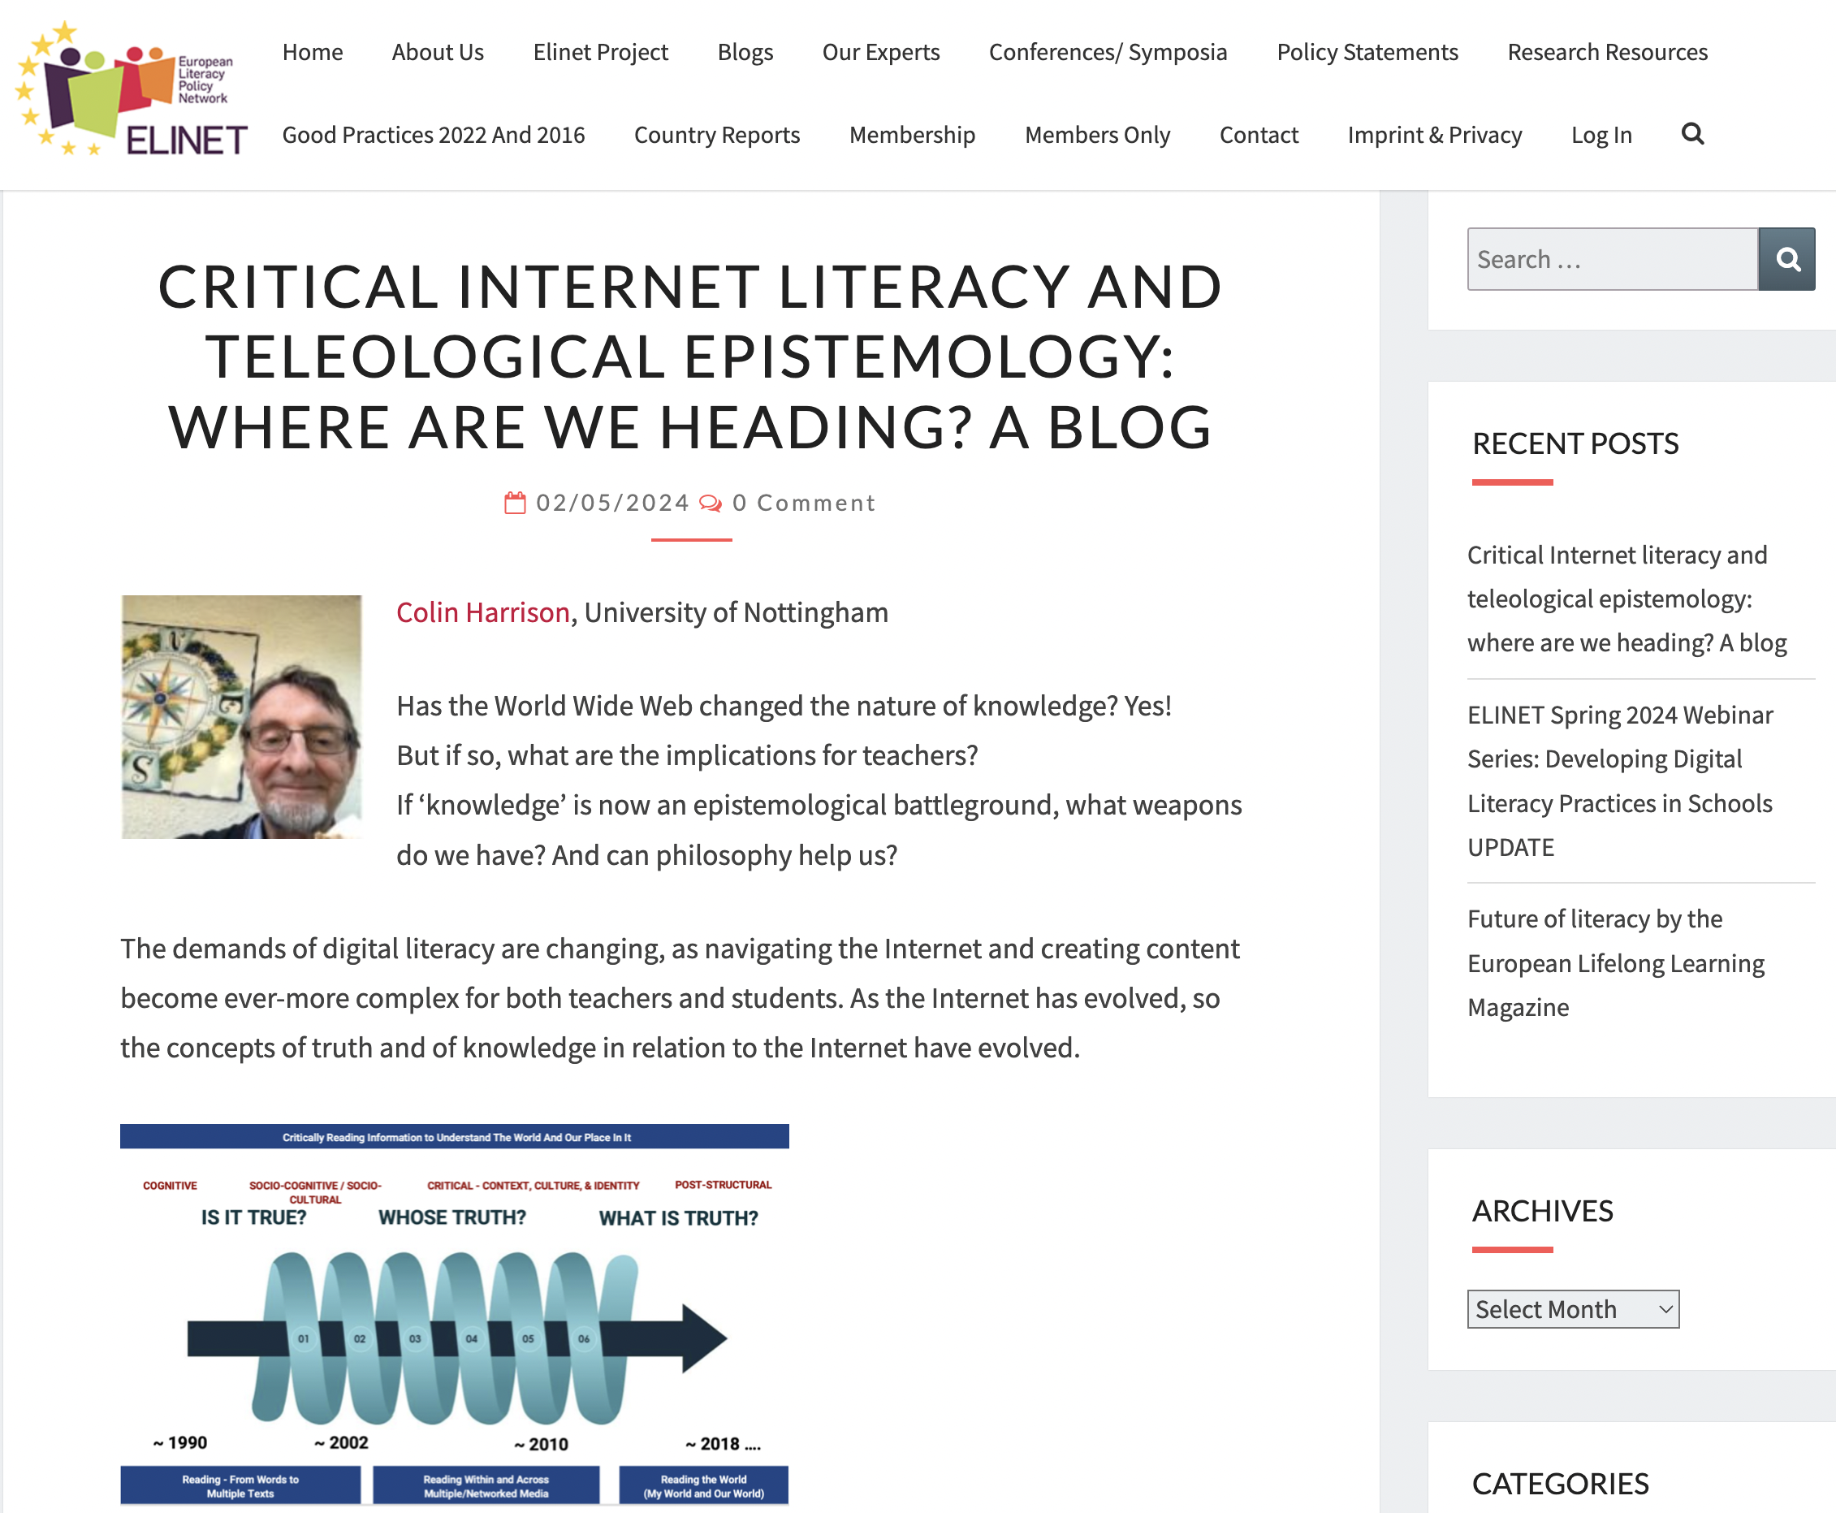
  What is the goal of Critical Digital Literacy?

Slide 10
Tim Berners-Lee creates a platform for ‘the free and open worldwide exchange of information’
Our final goal…
… is knowledge

Slide 11
Tim Berners-Lee creates a platform for ‘the free and open worldwide exchange of information’
‘Truth’ may be provisional, but some things we have learned from research:
  Every user of the Internet needs to develop and apply critical digital literacy
  Critical digital literacy can be taught: students in elementary schools are perfectly capable of applying rules such as “Be alert! Be suspicious!”, “Read between the lines,” “Make late decisions,” “Integrate information across sources,” and “Make joint decisions”
  Students working in groups can learn critical digital literacy collaboratively- they model it for each other
  Dialogue and uncertainty are the enemies of dogmatism and authoritarianism

Slide 12
Are iPhones the enemy?
  No- dogmatism and a lack of criticality are the enemy
  Agencies that try to mislead are the enemy
Is Artificial Intelligence the enemy?
  No- AI will continue to enrich (and save) our lives
  Teachers can use ChatGPT as an ally- humans are more creative than ChatGPT
  ChatGPT isn’t as clever as a human- it doesn’t understand The Onion: Yellowstone Bison Gores Woman Who Refused To Delete Unflattering Photograph

Slide 13
What are the most crucial tools that teachers have for developing criticality?
  Dialogue, discussion, accepting uncertainty, and modelling criticality for others
  The most crucial tools are our own students:
    Make them producers of knowledge
    Give them agency
    Make them co-producers of truth

Slide 14

Thank you!
Ευχαριστώ
Colin Harrison colin.harrison@nottingham.ac.uk

