Slide 1




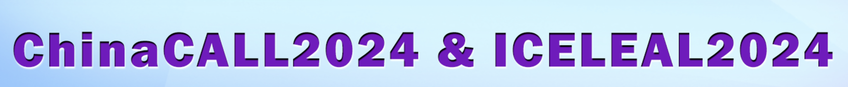

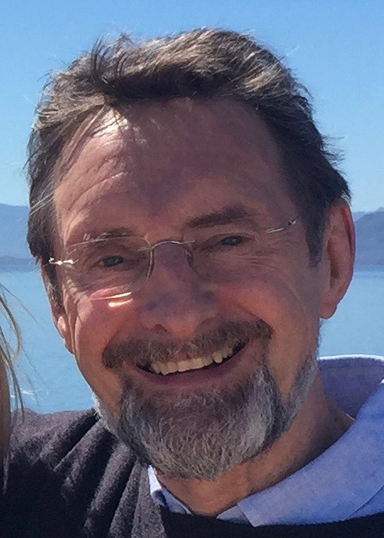
Keynote:
(Re-)Defining Critical Digital Literacy:
What Is It, and How Should We Teach It?
Colin Harrison University of Nottingham

Slide 2

Prologue
The Internet of (un)certainty
1990
Tim Berners-Lee set up the WorldWideWeb with the intention of creating a platform for ‘the free and open worldwide exchange of information’ (Berners-Lee and Cailliau, 1990).
Berners-Lee invented the URL (where is this page?)
HTML (builds the page) and HTTP (sends and checks the data)

Slide 3
2024
The Internet has the information:
5 billion users
1 billion websites
30 billion URLs

Slide 4
2024
The Internet has the information- but will it tell me what is true?

Slide 5
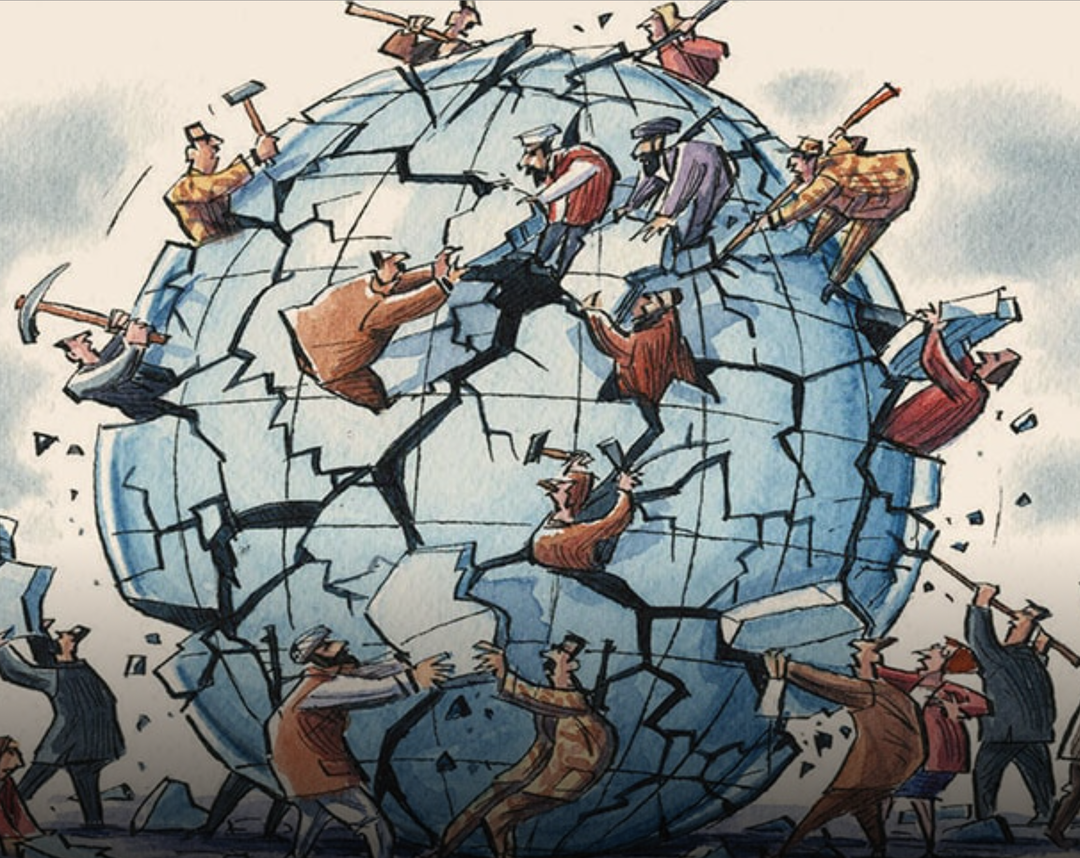
2024
The Internet has the information- but will it tell me what is true?

Slide 6
2024
The Internet has the information- but will it tell me what is true....?
Who was the greatest artist of all time?

Slide 7
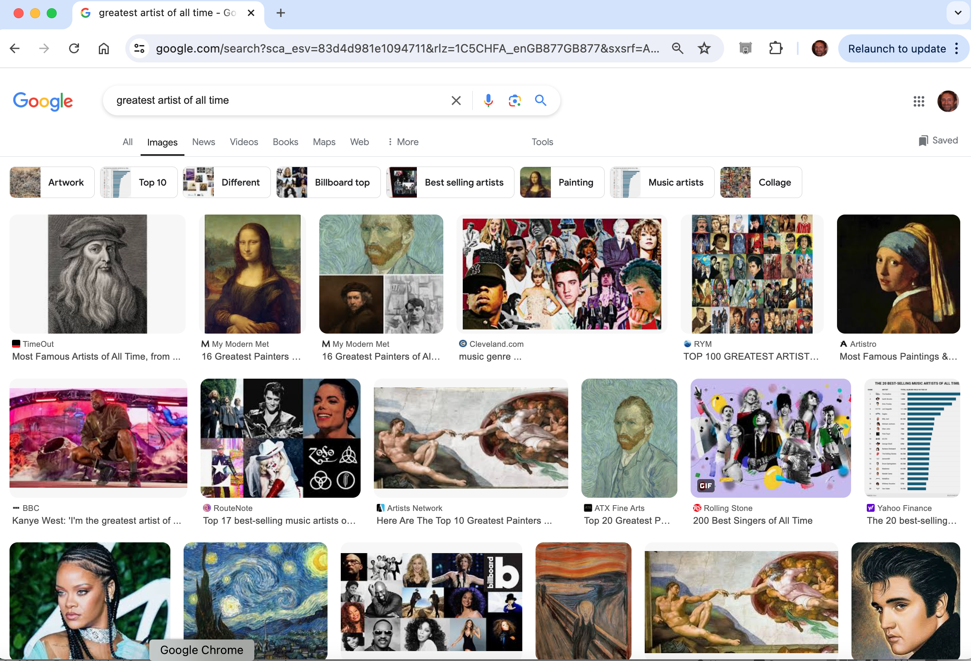

Slide 8

The Nymph of the Luo River – Gu Kaizhi

Slide 9
Has the Internet changed the nature of knowledge?

Slide 10
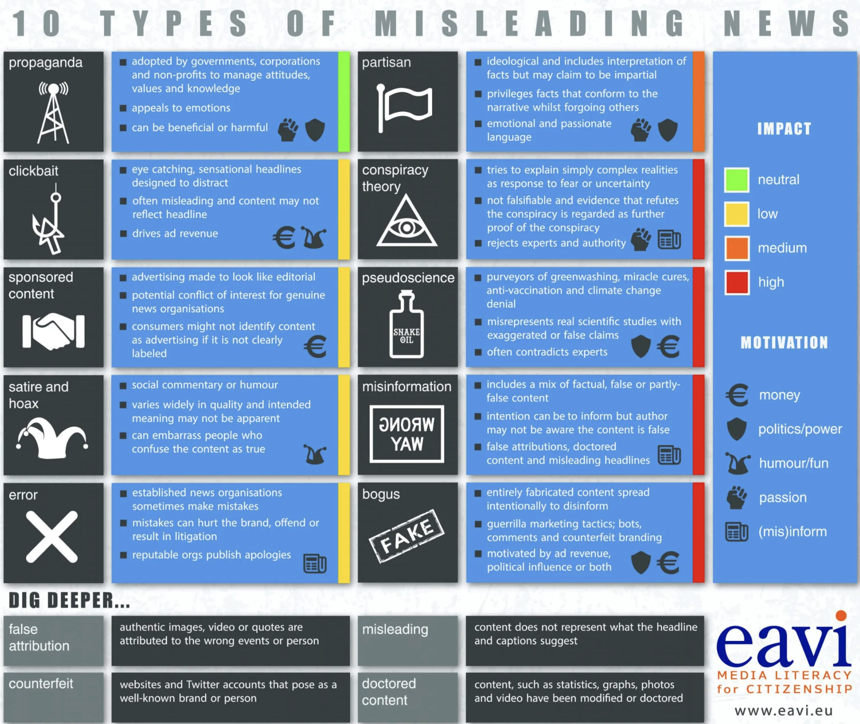
Has the Internet changed the nature of knowledge?

Slide 12
How PISA measures reading skills
In PISA 2022, reading proficiency is defined as follows:
“Reading literacy is understanding, using, evaluating, reflecting on and engaging with texts in order to achieve one’s goals, to develop one’s knowledge and potential, and to participate in society” (OECD, 2019[22]). PISA conceives of reading skills as a broad set of competencies that allows readers to engage with written information presented in one or more texts for a specific purpose.
Readers must understand the text and integrate this with their pre-existing knowledge. They must examine the author’s (or authors’) point of view and decide whether the text is reliable and truthful, and whether it is relevant to their goals or purpose.
Reading in the 21st century involves not only the printed page but electronic formats (i.e. digital reading). It requires triangulating different sources, navigating through ambiguity, distinguishing between fact and opinion, and constructing knowledge. During the pandemic, remote teaching initiatives heavily relied on the availability of digital education resources.”
OECD (2023) PISA 2022 Results (Volume I): The State of Learning and Equity in Education. Paris: OECD. https://doi.org/10.1787/53f23881-en (p. 83)

Slide 13
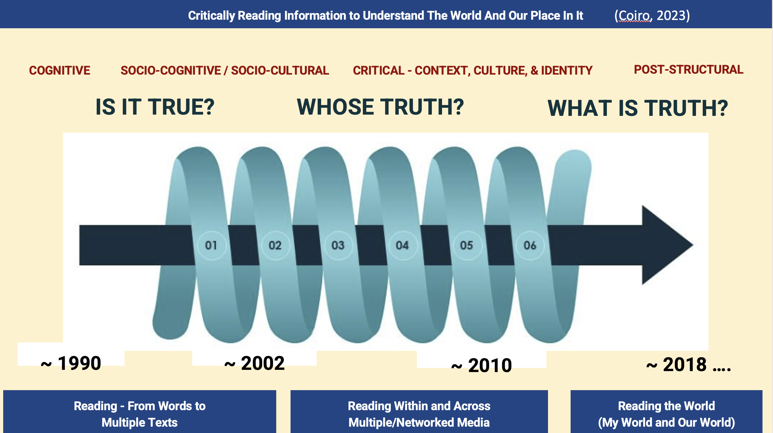
My three theoretical frameworks …and their implications (1, 2 and 3)
From Paulo Freire (1972):
All language transmits values as well as facts. Critical literacy does not simply read the world, it rewrites it. It changes the world.
1. The Internet gives us information → Humans give us knowledge
From Julie Coiro (2023):
2. 1990 Is it true? → 2018 What is truth?
Truth on the Internet is provisional, social and context-related
From Bakhtin (1929/1984/2013):
3. All learning is dialogic. → Teach CDL through dialogue; research CDL by evaluating dialogue

Slide 14

Critically Reading Information to Understand The World And Our Place In It
(Coiro, 2023)
COGNITIVE
SOCIO-COGNITIVE / SOCIO-CULTURAL
CRITICAL - CONTEXT, CULTURE, & IDENTITY
POST-STRUCTURAL
IS IT TRUE?
WHOSE TRUTH?
WHAT IS TRUTH?
COGNITIVE
~ 1990
~ 2002
~ 2010
~ 2018 ….
Reading - From Words to
Multiple Texts
Reading Within and Across Multiple/Networked Media
Reading the World
(My World and Our World)
Notes:
This timeline reflects my own personal journey to understand the overlapping nuances of critical reading rather than an entirely accurate historical timeline of the start and “end” of any particular way of thinking. Focus on informational text (rather than narrative); Spiral so they all still influence (some more than others), but different folks look at critical evaluation differently - different theoretical decisions shape different views about critical literacy - especially with respect to epistemic differences around the concept of knowledge and truth - the narrative of truth.

Slide 15
My three theoretical frameworks …and their implications (1, 2 and 3)
From Paulo Freire:
All language transmits values as well as facts. Critical literacy does not simply read the world, it rewrites it. It changes the world.
1. The Internet gives us information → Humans give us knowledge
From Julie Coiro:
2. 1990 Is it true? → 2018 onwards: What is truth?
Truth on the Internet is provisional and context-related
From Bakhtin:
3. All learning is dialogic. → Teach CDL through dialogue; research CDL by evaluating dialogue

Slide 16
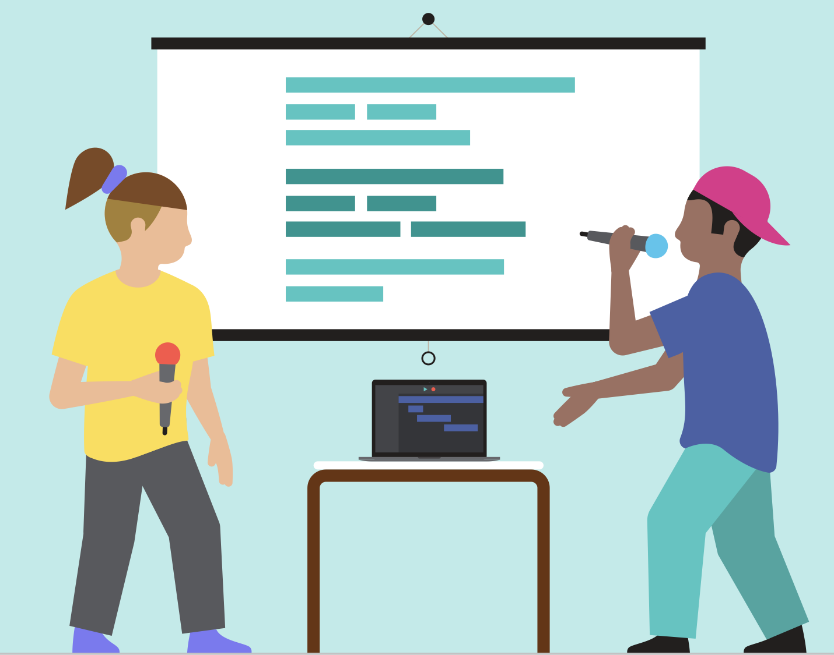

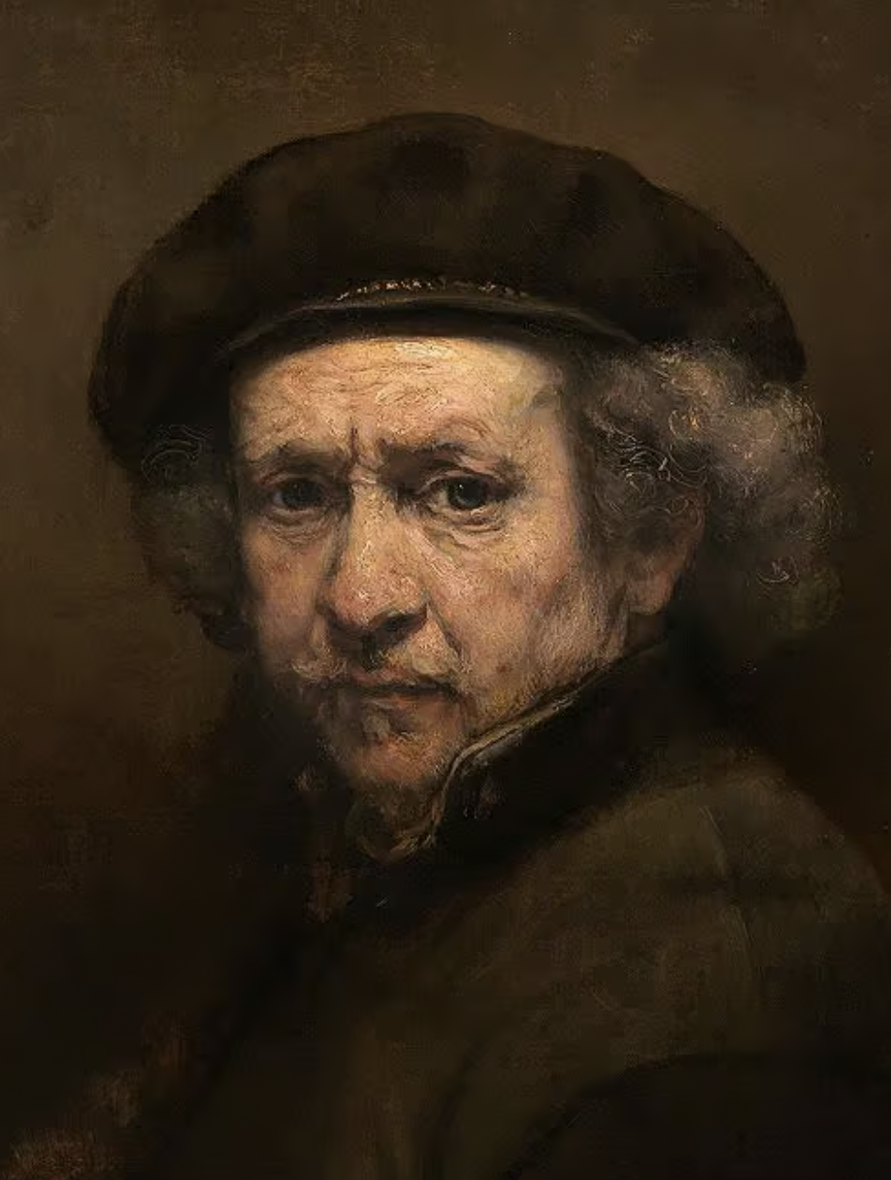
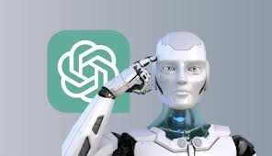
Three ways of looking at Critical Digital Literacy:
1. What can we learn about CDL from observing and listening to young children’s internet searching?
2. What can we learn about CDL from observing and listening to older students’ internet searching?
3. How do we reconsider CDL in the light of AI and ChatGPT?

Slide 17
Three ways of looking at Critical Digital Literacy:
1. What can we learn about CDL from observing and listening to young children’s internet searching?
2. What can we learn about CDL from observing and listening to older students’ internet searching?
3. How do we reconsider CDL in the light of AI and ChatGPT?

Slide 18
1. What can we learn about CDL from observing and listening to young children’s internet searching?
[Ng (2012) and many subsequent digital literacy researchers based their CDL scales on factor analysis of student (n>1000+) self-report questionnaire data....]
This IRB-approved study positions students as research partners; with their on-task discourse as the primary data (Dwyer, 2010)

Slide 19
1. Five triads of Grade 4 students (Planner, Evaluator, Navigator) recorded their Internet searching of six sites to answer the question 'How many stars can you see in the night sky?'
Where can we see CDL in action? (Harrison, 2018)

Slide 20
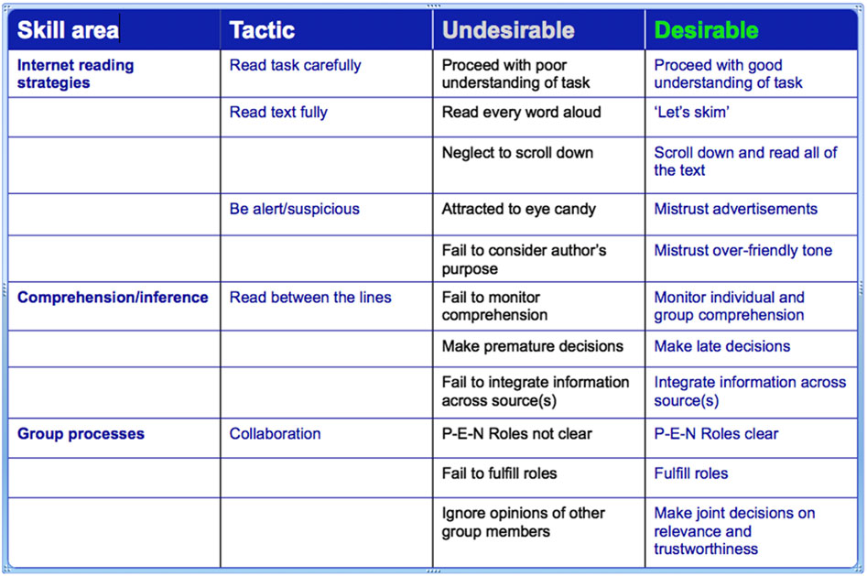

Slide 21
Jessica (Planner):
“Let’s just
look and see if it answers our question, because our
question is ‘How many stars can we see in the sky?’ So, we don’t just have to look for the biggest amount of
numbers.”

Slide 22
Chloë (Evaluator):
"Shall we, like, skim-read it, and see if we can find any
thing...?”

Slide 23
[The Navigator has a role here]

Slide 24
Chloë (Evaluator):
"Why are there cars advertised on this web site? "
Jessica (Navigator): "I don't trust it.... They are just trying to get money out of this site.”

Slide 25
Paige (Evaluator):
”It’s just trying to sound like your friend. I don’t trust it.”

Slide 26
Hildegarde (Planner): “Are you actually taking any of this in?”
Amie (grins): “No!”

Slide 27
Lucy (Planner):
”Let’s look at them all again.
We need to go on the one we trust most, and look at that again.”

Slide 28
Hannah (Planner): "Lets go back and look at the positives and negatives about them. This one you can tell it's real because it's got a caption below the picture. And you know the other website, some web
sites just want you to like them on Facebook.”

Slide 29
Amie: "I'm the evaluator, so I'm trying to see
that we're doing the right thing."
Lawrence: "I'm the
navigator, and you're the planner...."
Hildegard: "I'm
supposed to be telling you guys what to do!”

Slide 30
Logan (Planner):
"We've got to work together...'cause working together is key to answering the question.”

Slide 31
A grounded theory analysis of Critical Digital Literacy was developed (Strauss and Corbin, 1997).
After axial coding, the discourse segments clustered into four groups, which were on a rough continuum from naïve to thoughtfully critical:
1. Ingenuous (naïve, unquestioning, point/click, selecting the first site offered
2. Multimodal (recognizing the need for information from additional sources/confirmatory information/fresh search terms/rechecking earlier results)
3. Circumspect (showing caution about a site or source; caution over invited links)
4. Ambivalent (showing critical awareness of 'truth', judging ideology, remaining doubtful when faced with conflicting results)

Slide 32
Does our ‘Ambivalent’ category provide evidence of Critical Digital Literacy in action?
4. Ambivalent (showing critical awareness of the uncertainty of 'truth', intentionality/doubtful content)
Elementary school:
Sarah: Which of these two [sites] could be truer?
Jessica: I don't know whether to trust it, because it's using all scientific words, but you don't know whether it's all true.
Chlöe: They're both relevant, but I don't know whether they're true.
Hildergard: It's talking about star signs… Aren't they basically superstitions? It's like religion. Can we trust it? No.

Slide 33
Three ways of looking at Critical Digital Literacy:
1. What can we learn about CDL from observing and listening to young children’s internet searching?
2. What can we learn about CDL from observing and listening to older students’ internet searching?
3. How do we reconsider CDL in the light of AI and ChatGPT?

Slide 34
Triads (Planner, evaluator, navigator) of Year 9 students (mean age 15.6) were recorded doing two 20-minute Internet searches, based on challenging questions chosen by their teachers:
Science:
‘Who has had the most impact on attempting to prevent climate change?’
Humanities:
‘Who is the most talented artist ever to have existed?’

Slide 35
Is this evidence of critical digital literacy in action?
1. Ingenuous (naïve, unquestioning, point/click, selecting the first site offered)​
High school:
Jeffrey: It's asking me to accept cookies, so I usually go 'Accept all'.
Charlie: When you do a search, it's usually good to look at the top ones first- if it comes up first that means it's usually reliable to get information off… it's like Google is singling it out, that's one you need to look at.

Slide 36
Is this evidence of critical digital literacy in action?
2. Multimodal (recognizing the need for additional/confirmatory information/ fresh search terms/rechecking earlier site)​
High school:
Jessica: I would click on quite a few links to see if they match up, to be sure about it.

Slide 37
Is this evidence of critical digital literacy in action?
3. Circumspect (showing caution about a site or source; caution over invited links)​
High school:
Jeffrey: Wikipedia isn't a reliable website- 'cos people can change it.
Zara: I find it quite irritating if there's a pop-up straight away, and they ask you to click on a different link.
Alexander: I wouldn't click in the first link that comes up (on Google). You need to look at the little bit underneath. That might tell you what you really want to know. I would scroll down first.

Slide 38
Is this evidence of critical digital literacy in action?
4. Ambivalent Polyvalent; showing critical awareness of the uncertainty of 'truth’, considering intentionality/ideology of content
… or better to emphasize the dialogic nature of criticality?
4. Dialogic [phrase-level]: Chloe: “They're both relevant, but I don't know whether they're true.”
Jenny: “I don't trust ANY website!”
5. Sustained Dialogic: Evidence of collaborative argumentation (as in Neil Mercer’s Thinking Together); collaborative questioning of ideology (as in Bakhtin (2013):’Truth is not born nor is it to be found inside the head of an individual person, it is born between people collectively searching for truth, in the process of their dialogic interaction’. For Bakhtin, truth is ‘unfinalizble’)

Slide 39
Is this evidence of critical digital literacy in action?
5. Sustained Dialogic: Evidence of collaborative argumentation and collaborative questioning of ideology

Slide 40
Is this evidence of critical digital literacy in action?
Science research question: ‘Who has had the most impact on attempting to prevent climate change?’
Group G- an eclectic approach:
Sophie: ‘Click on any site that seems reliable’ [Circumspect]
[They find a site called 'The Apolitical Foundation'] Yolanda: It looks real.
Sophie: ...Trustworthy, yeah.
Jenny: I don't trust ANY website! [the others laugh, then read on in silence] [Circumspect? Dialogic?]
Group A- Maeve persuades the group to value direct effect on the planet, rather than on public opinion:
Initially Pablo says (00.11) ‘Right, so, what are we going to do first?’, and Maeve replies ‘We can find out, who, like, the main figures are, and we can see who you think is the bigger one.’ Diego immediately equates ‘impact’ with financial impact: ‘Who’s made the biggest donation? Jeff Bezos has donated about 10 million….’ [Naïve?]
The group then spend two minutes looking for data on philanthropic donations. But Maeve has a more tangible notion of impact (02.16) ‘I don't think we should base it on donations, I think we should base it on people who find different ways of doing things...’ and she then says why she holds this view (02.25), ‘cos they're donating because they're rich. It's the least they could do.’ This leads Pablo to change direction, and to search for ‘What inventions have prevented climate change?’
Pablo considers the inventions that this web search throws up, and makes a suggestion (02.50):
Pablo: We’ve got the ocean clean-up...
Maeve: We could look at who’s behind each of those. [Sustained Dialogic?]

Slide 41
Is this evidence of critical digital literacy in action?
Science research question: ‘Who has had the most impact on attempting to prevent climate change?’
Group A (continued)
Maeve (12.37): When we first looked, it mentioned Greta Thunberg and David Attenborough. We could see what they've actually done. They're more famous for their speeches than their work, so it might be interesting to see what they've actually done… I don't think Leonardo DiCaprio's done much actual campaigning….
Diego: David Attenborough is more focused on animals…. Seems like he's more speech related... Greta Thunberg brought more than 100 scientists and writers together…
Maeve: I think that's quite influential.
Diego- NPR- shall we just check the web site [on Greta Thunberg]? Looks pretty decent…. News, podcasts… looks pretty decent...age fifteen... school strikes…
Pablo- but was that doing anything to stop it? [climate change]
[The teacher asks if they’ve reached a conclusion]
Maeve: We think the answer is that Boyen Slat did the most, because unlike Greta Thunberg and David Attenborough and Leonardo DiCaprio, he set up a foundation that collected quite a lot of litter from the ocean, we think that the actual change in, like, helping the climate is more important than just spreading awareness.
[Sustained Dialogic]

Slide 42
Is this evidence of critical digital literacy in action?
Science research question: ‘Who has had the most impact on attempting to prevent climate change?’
Sustained Dialogic
Maeve: We think the answer is that Boyen Slat did the most, because unlike Greta Thunberg and David Attenborough and Leonardo DiCaprio, he set up a foundation that collected quite a lot of litter from the ocean, we think that the actual change in, like, helping the climate is more important than just spreading awareness.
Sustained Dialogic:
Evidence of collaborative argumentation (as in Neil Mercer’s Thinking Together project);
Evidence of collaborative questioning of ideology (as in Bakhtin (2013):”Truth is not born, nor is it to be found inside the head of an individual person: it is born between people collectively searching for truth, in the process of their dialogic interaction’. Truth is unfinalizble”.

Slide 43
Three ways of looking at Critical Digital Literacy:
1. What can we learn about CDL from observing and listening to young children’s internet searching?
2. What can we learn about CDL from observing and listening to older students’ internet searching?
3. How do we reconsider CDL in the light of AI and ChatGPT?

Slide 44
3. How do we reconsider Critical Digital Literacy in the light of AI and ChatGPT?

Slide 45
3. How do we reconsider Critical Digital Literacy in the light of AI and ChatGPT?
Is AI a threat to education, and particularly to language educators?

Slide 46
3. How do we reconsider Critical Digital Literacy in the light of AI and ChatGPT?
Is AI a threat to education, and particularly to language educators?
Can generative AI write a better essay than a student?

Slide 47
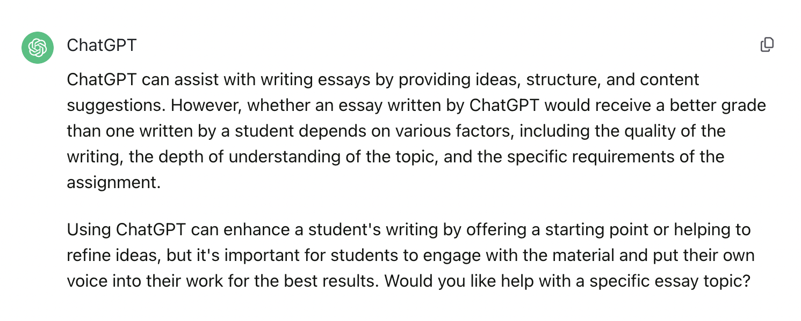
3. How do we reconsider Critical Digital Literacy in the light of AI and ChatGPT?
Is AI a threat to education, and particularly to language educators?
Can generative AI write a better essay than a student?

Slide 48
3. How do we reconsider Critical Digital Literacy in the light of AI and ChatGPT?
Is AI a threat to education, and particularly to language educators?
Can generative AI write a better essay than a student?
Will ChatGPT lead to chaos in terms of students cheating?

Slide 49
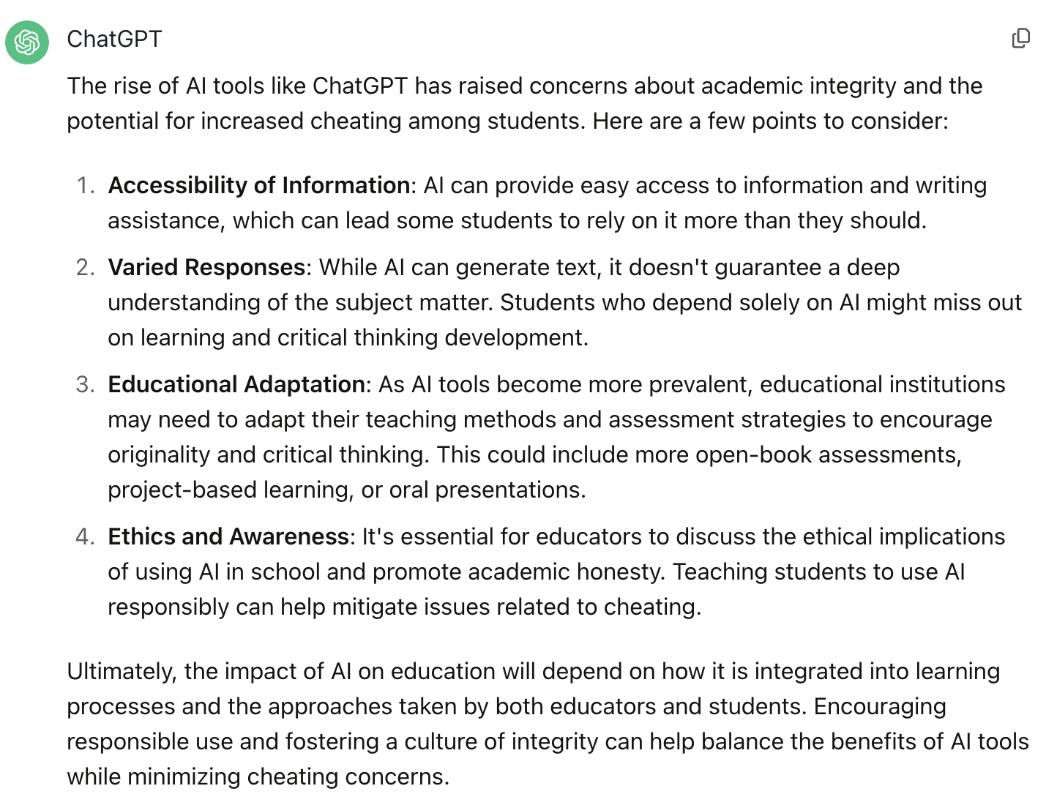
3. How do we reconsider Critical Digital Literacy in the light of AI and ChatGPT?
Is AI a threat to education, and particularly to language educators?
Can generative AI write a better essay than a student?
Will ChatGPT lead to chaos in terms of students cheating?

Slide 50
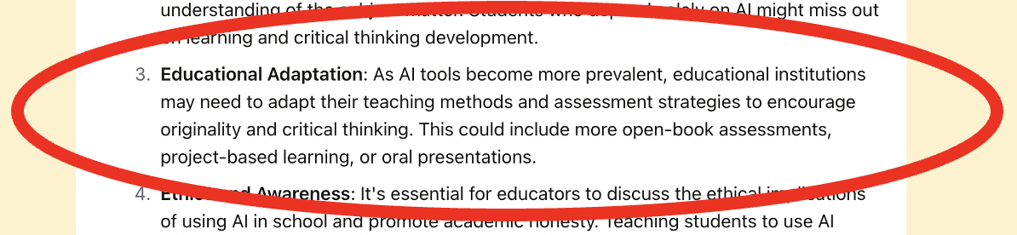
3. How do we reconsider Critical Digital Literacy in the light of AI and ChatGPT?
Is AI a threat to education, and particularly to language educators?
Can generative AI write a better essay than a student?
Will ChatGPT lead to chaos in terms of students cheating?

Slide 51

3. How do we reconsider Critical Digital Literacy in the light of AI and ChatGPT?
Is AI a threat to education, and particularly to language educators?
Can generative AI write a better essay than a student?
Will ChatGPT lead to chaos in terms of students cheating?
?

Slide 52
3. How do we reconsider Critical Digital Literacy in the light of AI and ChatGPT?
How does ChatGPT define Critical Digital Literacy?
Critical digital literacy refers to the ability to critically engage with and navigate the digital world, including understanding, evaluating, and creating digital content. It involves a set of skills and competencies that go beyond basic digital literacy, which focuses on the functional use of digital tools. Critical digital literacy emphasizes the capacity to analyze information, assess its reliability, and comprehend the broader social, cultural, and ethical implications of digital technologies.
Key components of critical digital literacy include:
Critical Thinking: The ability to analyze and evaluate digital information, distinguishing between credible and unreliable sources. This involves questioning assumptions, recognizing biases, and considering multiple perspectives.
Media Literacy: Understanding how media is created, distributed, and consumed in the digital age. This includes being aware of the persuasive techniques used in digital media and recognizing how different media forms shape information.
Information Literacy: The skill to locate, assess, and use information effectively in digital environments. This involves evaluating the credibility of online sources, understanding data privacy issues, and recognizing potential misinformation.
Digital Citizenship: Awareness of ethical and responsible behavior in online spaces. This includes understanding issues related to cyberbullying, online privacy, and respecting intellectual property rights.
Creation and Communication: The ability to produce and share digital content responsibly. This involves creating original digital media, understanding copyright laws, and considering the impact of digital communication on diverse audiences.
In a rapidly evolving digital landscape, critical digital literacy is crucial for individuals to navigate the complexities of the digital world and make informed decisions in their personal, academic, and professional lives. It empowers individuals to be active and discerning participants in the digital society.

Slide 53
Critical Thinking: The ability to analyze and evaluate digital information, distinguishing between credible and unreliable sources. This involves questioning assumptions, recognizing biases, and considering multiple perspectives.
Me- : Write a 200-word bio of Prof Colin Harrison
ChatGPT:
Professor Colin Harrison is a renowned expert in the field of education and technology, with a specific focus on innovative teaching strategies and the integration of digital tools in learning environments. He holds a Ph.D. in Educational Technology and has spent over two decades at the forefront of research aimed at enhancing student engagement through technology.
As a member of various academic committees, Colin has contributed to shaping educational policies and practices within higher education institutions. He is a sought-after speaker at international conferences, where he shares his insights on the future of education, and has published numerous articles in prestigious journals. His work emphasizes the importance of adaptive learning and the role of artificial intelligence in personalizing educational experiences for diverse learners.
In addition to his academic pursuits, Professor Harrison actively collaborates with several tech companies to develop educational software aimed at improving classroom experiences. His dedication to innovative education solutions has earned him several awards, including the National Teaching Award. Outside of academia, Colin is passionate about mentoring future educators, helping them to integrate technology effectively into their teaching methodologies. He continues to inspire educators and students alike with his forward-thinking approach to education.

Slide 54
Critical Thinking: The ability to analyze and evaluate digital information, distinguishing between credible and unreliable sources. This involves questioning assumptions, recognizing biases, and considering multiple perspectives.
This would seem to be true!
Me- : Write a 200-word bio of Prof Colin Harrison
ChatGPT:
Professor Colin Harrison is a renowned expert in the field of education and technology, with a specific focus on innovative teaching strategies and the integration of digital tools in learning environments. He holds a Ph.D. in Educational Technology and has spent over two decades at the forefront of research aimed at enhancing student engagement through technology.
As a member of various academic committees, Colin has contributed to shaping educational policies and practices within higher education institutions. He is a sought-after speaker at international conferences, where he shares his insights on the future of education, and has published numerous articles in prestigious journals. His work emphasizes the importance of adaptive learning and the role of artificial intelligence in personalizing educational experiences for diverse learners.
In addition to his academic pursuits, Professor Harrison actively collaborates with several tech companies to develop educational software aimed at improving classroom experiences. His dedication to innovative education solutions has earned him several awards, including the National Teaching Award. Outside of academia, Colin is passionate about mentoring future educators, helping them to integrate technology effectively into their teaching methodologies. He continues to inspire educators and students alike with his forward-thinking approach to education.

Slide 55
Critical Thinking: The ability to analyze and evaluate digital information, distinguishing between credible and unreliable sources. This involves questioning assumptions, recognizing biases, and considering multiple perspectives.
Vague- four decades!
Vague!
Wrong!
Me- : Write a 200-word bio of Prof Colin Harrison
ChatGPT:
Professor Colin Harrison is a renowned expert in the field of education and technology, with a specific focus on innovative teaching strategies and the integration of digital tools in learning environments. He holds a Ph.D. in Educational Technology and has spent over two decades at the forefront of research aimed at enhancing student engagement through technology.
As a member of various academic committees, Colin has contributed to shaping educational policies and practices within higher education institutions. He is a sought-after speaker at international conferences, where he shares his insights on the future of education, and has published numerous articles in prestigious journals. His work emphasizes the importance of adaptive learning and the role of artificial intelligence in personalizing educational experiences for diverse learners.
In addition to his academic pursuits, Professor Harrison actively collaborates with several tech companies to develop educational software aimed at improving classroom experiences. His dedication to innovative education solutions has earned him several awards, including the National Teaching Award. Outside of academia, Colin is passionate about mentoring future educators, helping them to integrate technology effectively into their teaching methodologies. He continues to inspire educators and students alike with his forward-thinking approach to education.
Guesswork!
Vague!
Wrong!
Wrong!

Slide 56
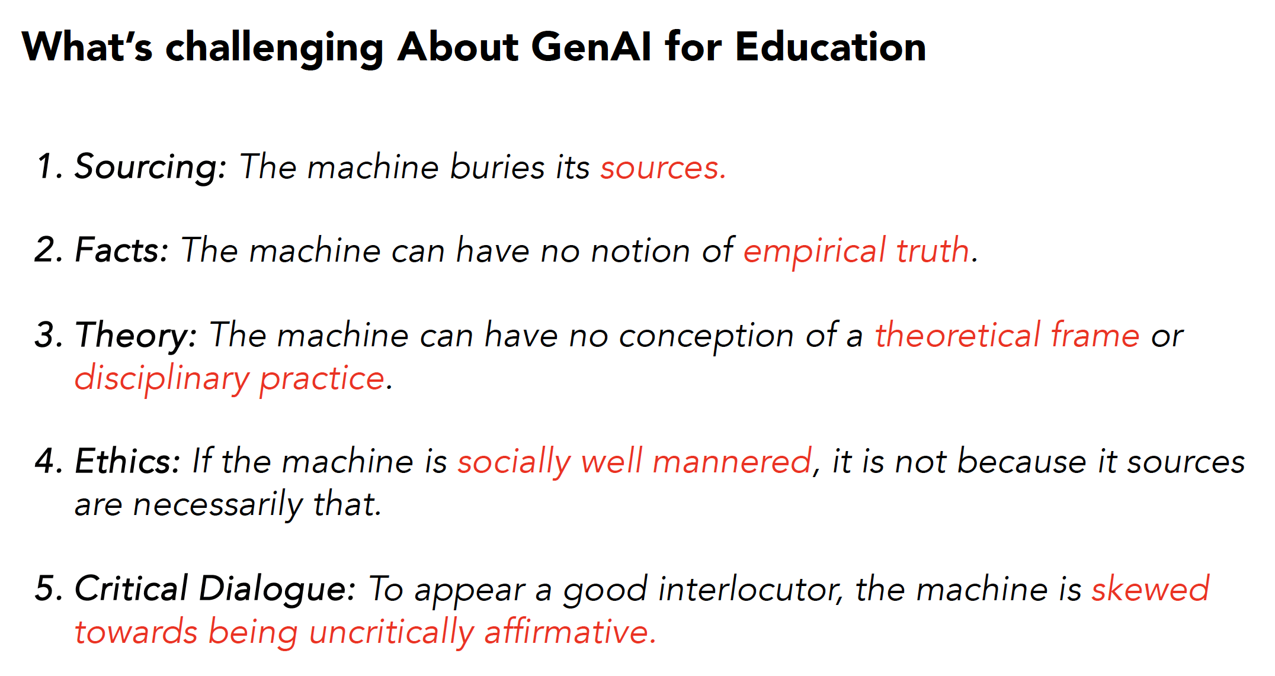
Critical Thinking: The ability to analyze and evaluate digital information, distinguishing between credible and unreliable sources. This involves questioning assumptions, recognizing biases, and considering multiple perspectives.

Slide 57
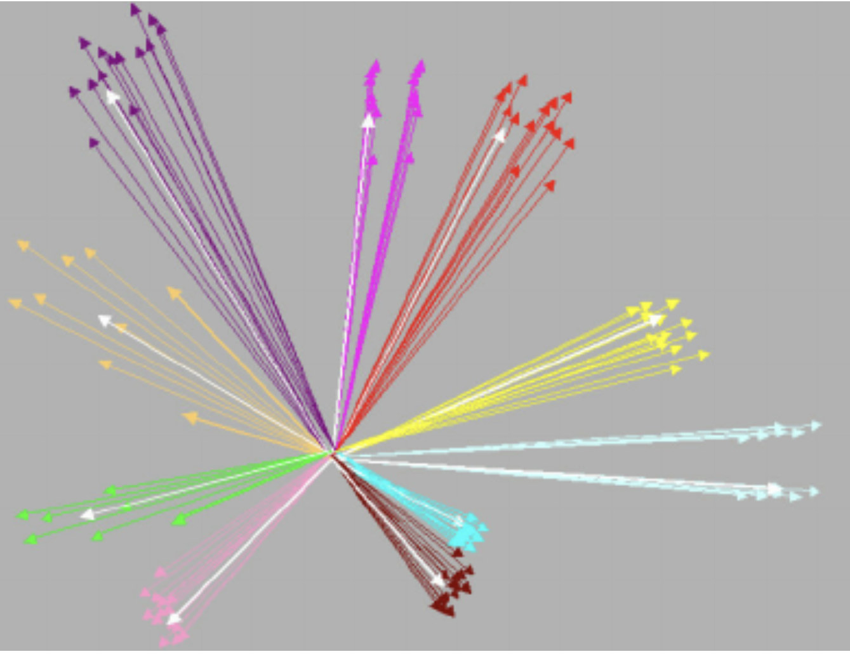
Critical Thinking: The ability to analyze and evaluate digital information, distinguishing between credible and unreliable sources. This involves questioning assumptions, recognizing biases, and considering multiple perspectives.
Is ‘Artificial Intelligence’ in ChatGPT3.5 ‘Intelligence’?
– it’s a mathematical representation of the relationship between words … or n-grams…
Words can be represented as locations in an n-dimensional semantic space, in which words that tend to occur together are located near each other.
GPT 3.5 is based on a corpus of 500 billion n-grams, and basically all it does is to predict the next n-gram in a series, which could be a space, a letter, a punctuation mark, a word, or part of a word- but it’s not very clever…
It needs a human- or humans- to guide it away from generating nonsense, and towards generating useful information.

Slide 58
Critical Thinking: The ability to analyze and evaluate digital information, distinguishing between credible and unreliable sources. This involves questioning assumptions, recognizing biases, and considering multiple perspectives.
So how do we use AI and ChatGPT to support our teaching rather than subverting our pedagogy?

Slide 59
So how do we use AI and ChatGPT to support our teaching rather than subvert our pedagogy?
Five Key Pedagogical Approaches to increase Critical Digital Literacy
1 Use a dialogic approach, with students working together on ChatGPT
2 Use a dialogic approach, modelling desirable behaviour (T-S; S-S)
3 Defeat AI/ChatGPT by getting students to use it for composition
4 Defeat AI/ChatGPT by getting students to find errors and weaknesses
5 Defeat AI/ChatGPT by getting students to use it to become producers

Slide 60
Five Key Pedagogical Approaches to increase Critical Digital Literacy
1 Use a dialogic approach, with students working together on ChatGPT
  What did Chloë do? (Made copies for students of AI-based assignment)
  The students worked in pairs to discuss the assignment
  Whole class discussion of the AI assignment- and its probable ‘author’!

Slide 61
Five Key Pedagogical Approaches to increase Critical Digital Literacy
2 Use a dialogic approach, modelling desirable behaviour (T-S; S-S)
  Make life difficult for AI by setting homework that requires
    Connections to the student’s own life experience
    Connections to the student’s own prior knowledge
    A demonstration of how the student’s sources led to the answer
    Then the class shares how they built their answers

Slide 62
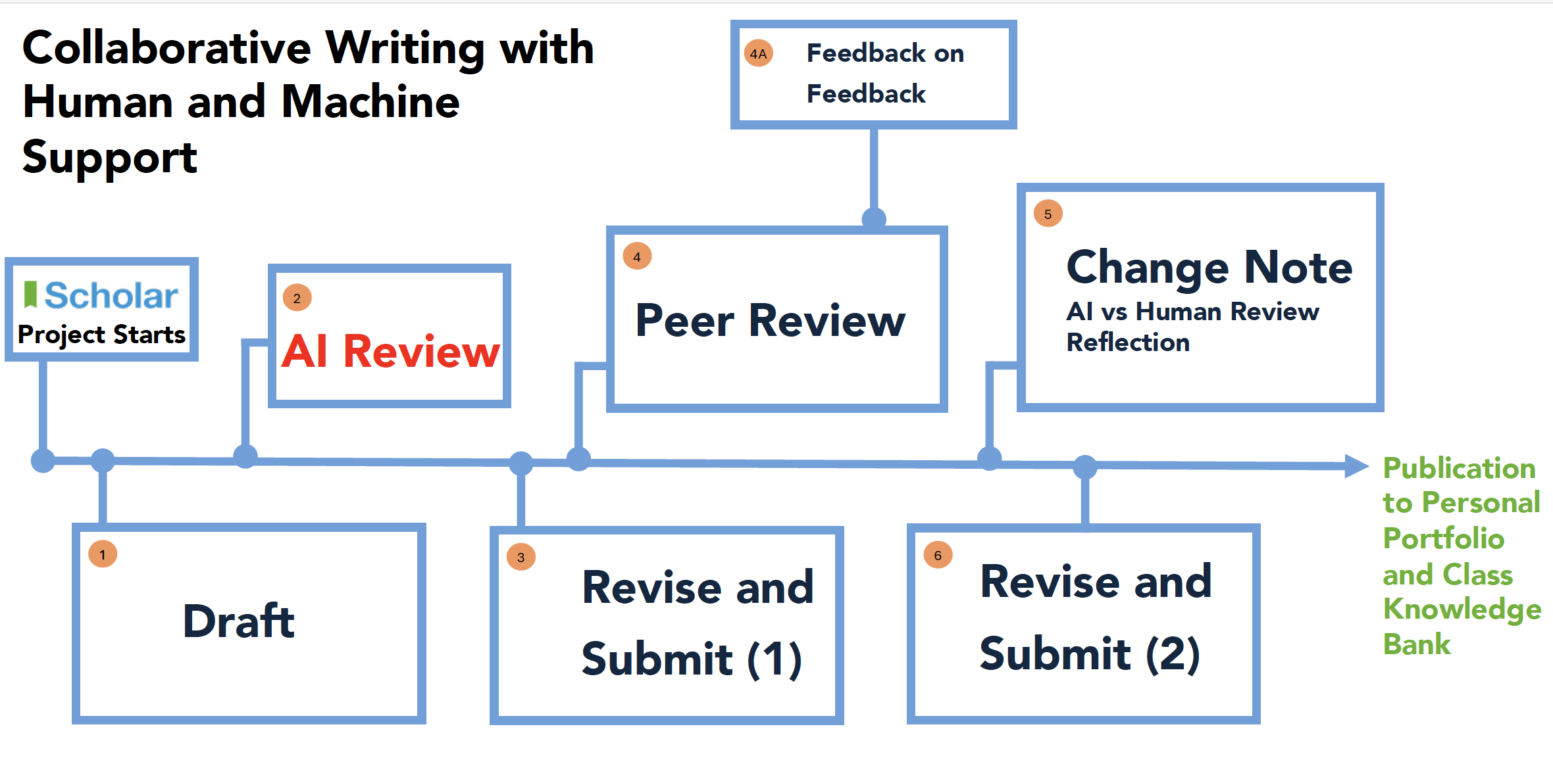
Five Key Pedagogical Approaches to increase Critical Digital Literacy
3 Defeat AI/ChatGPT by getting students to use it for composition
Saini, A. K., Cope, B., Kalantzis, M., & Zapata, G. C. (2024). The Future of Feedback: Integrating Peer and Generative AI Reviews to Support Student Work.

Slide 63
Five Key Pedagogical Approaches to increase Critical Digital Literacy
Defeat AI/ChatGPT by getting students to find errors and weaknesses
Students generate ChatGPT answers, then work in pairs or triads through DIALOGUE to identify factual errors, poor style, bias, vagueness, and to construct better answers. Then they report back to their classmates, thus MODELLING Critical Digital Literacy for others

Slide 64
Five Key Pedagogical Approaches to increase Critical Digital Literacy
5 Defeat AI/ChatGPT by getting students to use it to become producers
Instead of being simply consumers of information, students work collaboratively through DIALOGUE to become multimedia producers of knowledge. PRODUCTION is the most powerful tool in the CDL box.
The Internet, and its AI tools produce information, but knowledge comes after you’ve not only found the facts, but have begun to integrate those facts into a personal network of interpretations, values, viewpoints, theories, and truth-values
The Internet produces information; only humans produce knowledge

Slide 65
We have looked at Critical Digital Literacy in three ways:
1. What can we learn about CDL from observing and listening to young children’s internet searching?
2. What can we learn about CDL from observing and listening to older students’ internet searching?
3. How do we reconsider developing CDL in the light of AI and ChatGPT?

Slide 66
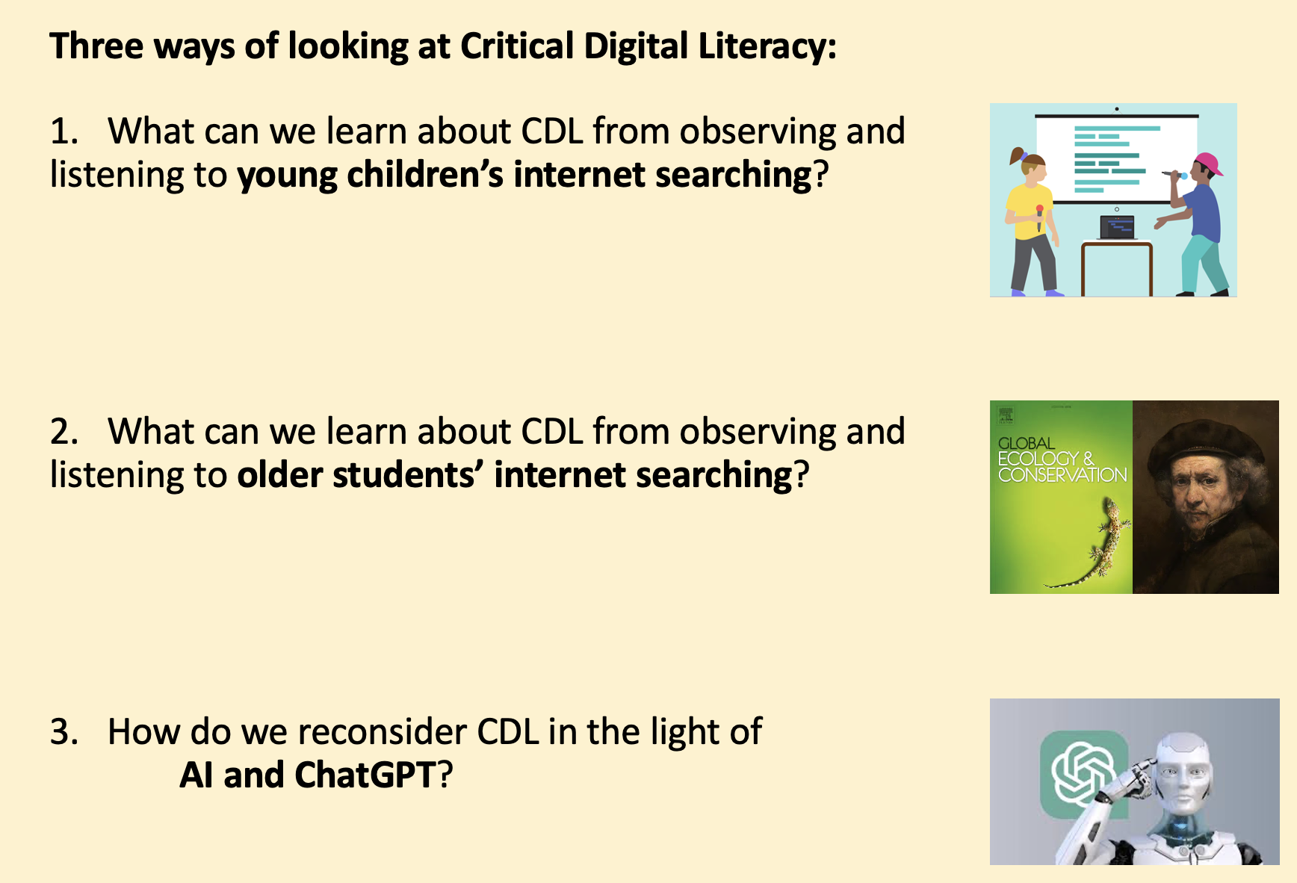

Freire:
All learning is dialogic
Bakhtin:
Truth is unfinalizable

Slide 67
Keynote:
(Re-)Defining Critical Digital Literacy:
What Is It, and How Should We Teach It?
Colin Harrison University of Nottingham
colin.harrison@nottingham.ac.uk
Thank you!
祝好！
Notes:
Chi-ay! Chi-ay!

Slide 68
References
Bakhtin, M. (2013). Problems of Dostoevsky's poetics (Vol. 8). U of Minnesota Press.
Berners-Lee, T. J., & Cailliau, R. (1990). WorldWideWeb: Proposal for a HyperText project. https://cds.cern.ch/record/2639699/files/Proposal_Nov-1990.pdf
Coiro, J. (2023) Critically Reading Information To Understand the World And Our Place In It: Diverse Perspectives and Related Challenges for Research & Practice. Presentation at the Literacy Research Association annual conference, Atlanta, 2023.
Dwyer, B. (2010). Scaffolding Internet reading: A study of a disadvantaged school community in Ireland (PhD, University of Nottingham).
Farag, A., Greeley, L., & Swindell, A. (2023). Freire 2.0: Pedagogy of the digitally oppressed. In Paulo Freire Centennial (pp. 62-75). Routledge. https://doi.org/10.1080/00131857.2021.2010541
Freire, P. (1972). Pedagogy of the Oppressed. Translated by Myra Bergman Ramos. Sheed and Ward, London.
Harrison, C. (2018). Defining and seeking to identify critical Internet literacy: a discourse analysis of fifth‐graders' Internet search and evaluation activity. Literacy, 52(3), 153-160. https://colinharrison.org/wp-content/uploads/2020/06/f2214-cil-literacy-2018.pdf
Kiili, C., & Kulju, P. (2024) Empowering teachers to educate critical online readers. Online source, accessed 26 July 2024. https://research.tuni.fi/uploads/sites/1033/1033/10/fbff043c-kiili_kulju_empowering-teachers-to-educate-critical-online-readers.pdf
Landauer, T. K., Foltz, P. W., & Laham, D. (1998). An introduction to latent semantic analysis. Discourse processes, 25(2-3), 259-284.
Mercer, N. (2002). Words and minds: How we use language to think together. Routledge.
OECD (2023) PISA 2022 Results (Volume I): The State of Learning and Equity in Education. Paris: OECD. https://doi.org/10.1787/53f23881-en
Saini, A. K., Cope, B., Kalantzis, M., & Zapata, G. C. (2024). The Future of Feedback: Integrating Peer and Generative AI Reviews to Support Student Work. https://www.researchgate.net/profile/Gabriela-Zapata-5/publication/380613474_The_Future_of_Feedback_Integrating_Peer_and_Generative_AI_Reviews_to_Support_Student_Work/links/6673e8ed1dec0c3c6f93f295/The-Future-of-Feedback-Integrating-Peer-and-Generative-AI
Strauss, A. L., & Corbin, J. M. (1997). Grounded theory in practice. Sage.

